Slide 1
Mathew Safarian
Assistant Headteacher –
St Francis of Assisi Primary School
(Notting Hill)
Sasha Marius-Beeko
Teaching and Learning Lead
George Eliot Primary
Notes:
Mat - mem stick.
Sash - resources.
MAT

Slide 2
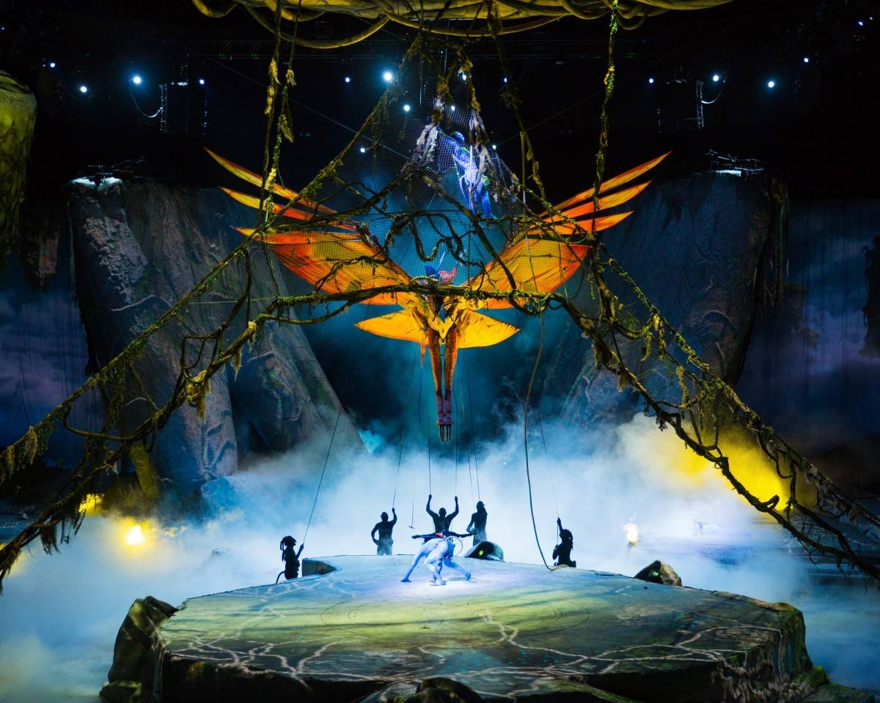
Project overview
What is it all about?
How will you do it?
What do you hope to achieve at the end of the project?
Notes:
SASH

Slide 3
Totem and its place in the curriculum
Design
Generate, develop, model and communicate their ideas through discussion, annotated sketches, cross-sectional and exploded diagrams, prototypes, pattern pieces and computer-aided design.
Make
Select from and use a wider range of tools and equipment to perform practical tasks [for example, cutting, shaping, joining and finishing], accurately.
Select from and use a wider range of materials and components, including construction materials, textiles and ingredients, according to their functional properties and aesthetic qualities.
Notes:
MAT

Slide 4
Totem and its place in the curriculum
Evaluate
Evaluate their ideas and products against their own design criteria and consider the views of others to improve their work.
Understand how key events and individuals in design and technology have helped shape the world.
Technical knowledge
Apply their understanding of how to strengthen, stiffen and reinforce more complex structures.
Understand and use mechanical systems in their products [for example, gears, pulleys, cams, levers and linkages].
Notes:
MAT

Slide 5
Warm up-
You will need to work in groups of 3. Each group will be given 3 sheets of A3 paper. You will be have 4 minutes to build the tallest possible free-standing tower. No other equipment can be used.
Group task
Discuss the challenges of a task like this.
What would you do differently next time?
What would have made the difference to your group?
What difficulties do you think will come up when you begin the collaborative work in your class?
Notes:
Sasha to change - Build the biggest standalone tower out of x3 A3 paper.
What are the three essential things that would make this project successful? (What would you teach first?)
SASH

Slide 6
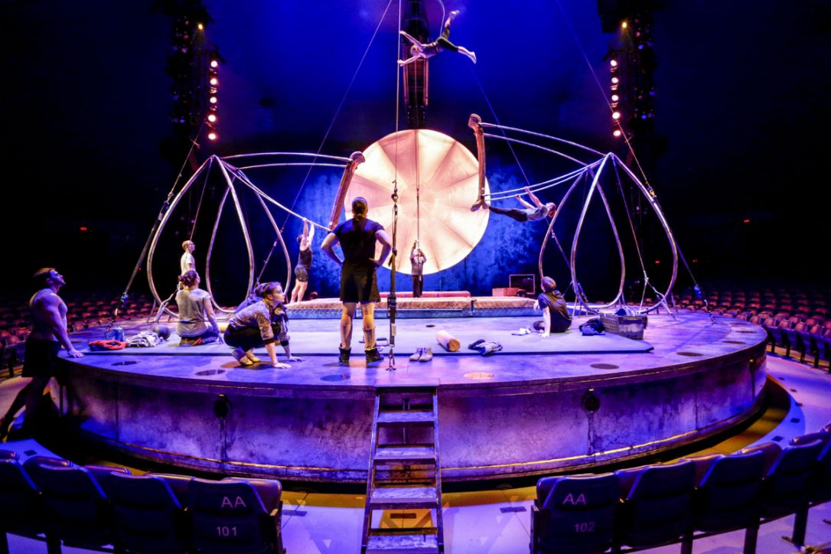
Design brief number one: Revolving stage.
Notes:
MAT

Slide 7
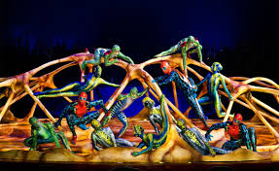
Notes:
SASH

Slide 8
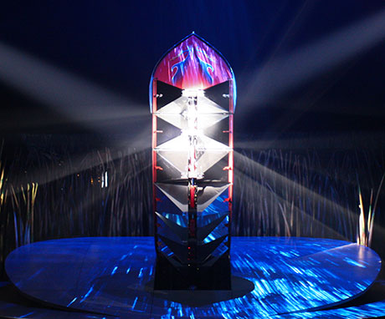
Notes:
MAT

Slide 9
Suggested teaching programme and activities
Session 1: The Brief & Research
Introduce the students to the design brief you have chosen from the three suggested. In their groups, students use a range of sources to begin to understand how a structure or mechanism might be created.
Session 2: Generate & evaluate ideas about mechanisms.
Have out the range of materials that will be used to make the students’ eventual design and allow time for them to experiment with the materials and mechanisms. Interrogate how movement is generated and use kit to simulate movement.
Notes:
SASH

Slide 10
Suggested teaching programme and activities
Sessions 3 & 4: Construct a Prototype (Engineer visit one)
Use a planning sheet to help them develop their initial designs. You could use a sheet individually or in groups. In an initial session, each of the team members can draw four designs before choosing one and refining it further. Students work as a team to create a ‘working’ model of their design. Throughout this process, encourage the students to refer to the original design brief as well as their findings from the first week.
Notes:
MAT

Slide 11
Suggested teaching programme and activities
Session 5: Detailed Design
Have the students test their prototype against the original design brief. They should identify any weaknesses in the design and any other aspect that can be improved. They should then go through the design process again, using the planning sheet, to finalise their prototype.
Sessions 6 & 7: Manufacture (Engineer visit two)
With their improved designs, students should produce a final product of their work, paying careful attention to the details of their design and ensuring that all mechanisms work correctly.
Notes:
SASH

Slide 12
Suggested teaching programme and activities
Session 8: Evaluate
Students will need to test the product again and evaluate its effectiveness, relative to the brief. An informal presentation will need to be made that explains the design brief and specification generated as a group for the Presentation Day at the Royal Albert Hall – presentations will be done in three sets of 5 schools (whilst the remainder of the schools visit these five stations) so students are not expected to present to the entire room.
Notes:
SASH

Slide 13
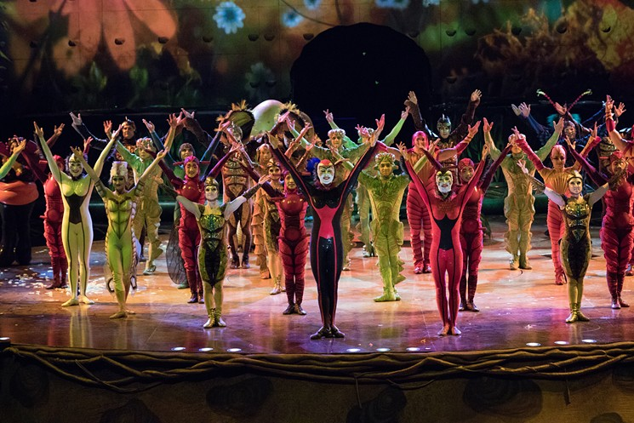
Our sequence!
Pre-show Pre engineer visits Engineer visits Post engineer
Front cover page.
Explore what engineering means to you (use of ICT/HW) - look at examples of engineering around us!
Group task (spaghetti structures/paper bridges etc.)
Create three design ideas as a group. Annotate through labelled diagrams what will be used and how it will work.
Refine ideas to one chosen design brief. Create a page detailing exactly what will happen and how you will get there.
Begin the constructing (Rolls Royce visit 1).
Evaluate and adapt plans following visit. Continue constructing.
Construction continues (Rolls Royce visit 2).
Finish and evaluate against original brief.
Prepare for the presentation.
Notes:
MAT

Slide 14
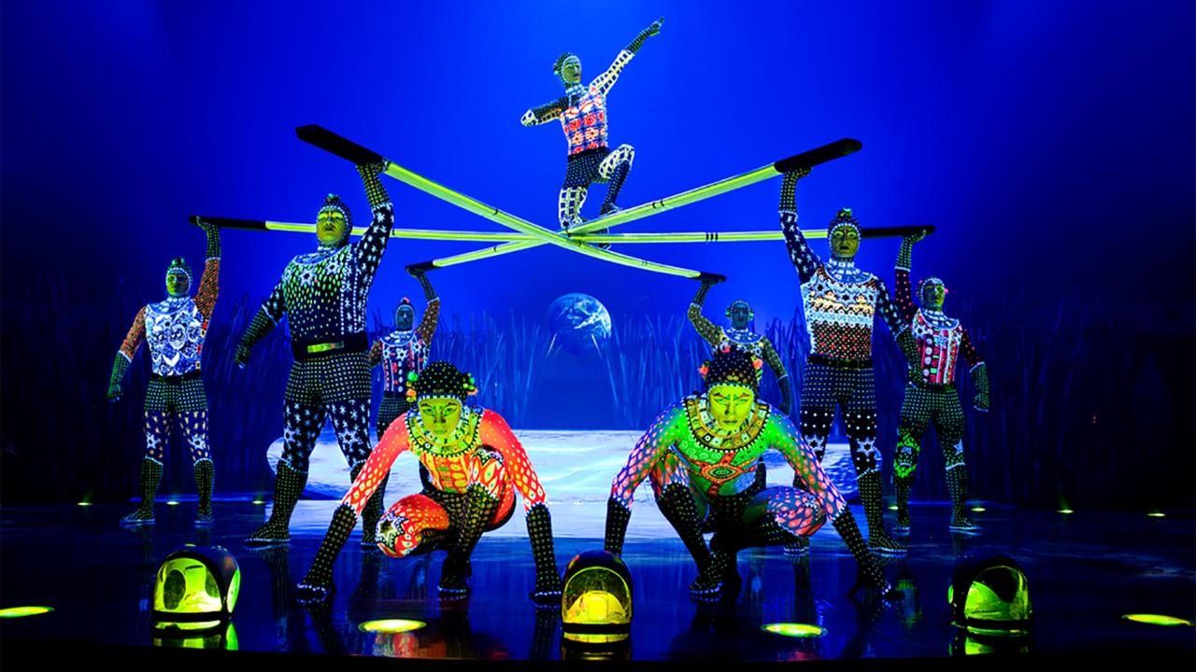
Maximising Rolls Royce – be prepared!
The two visits from Rolls Royce are the most valuable sessions in your sequence. Be prepared for them, be organised and use them in the best way possible!
Notes:
SASH

Slide 15
Notes:
MAT

Slide 16
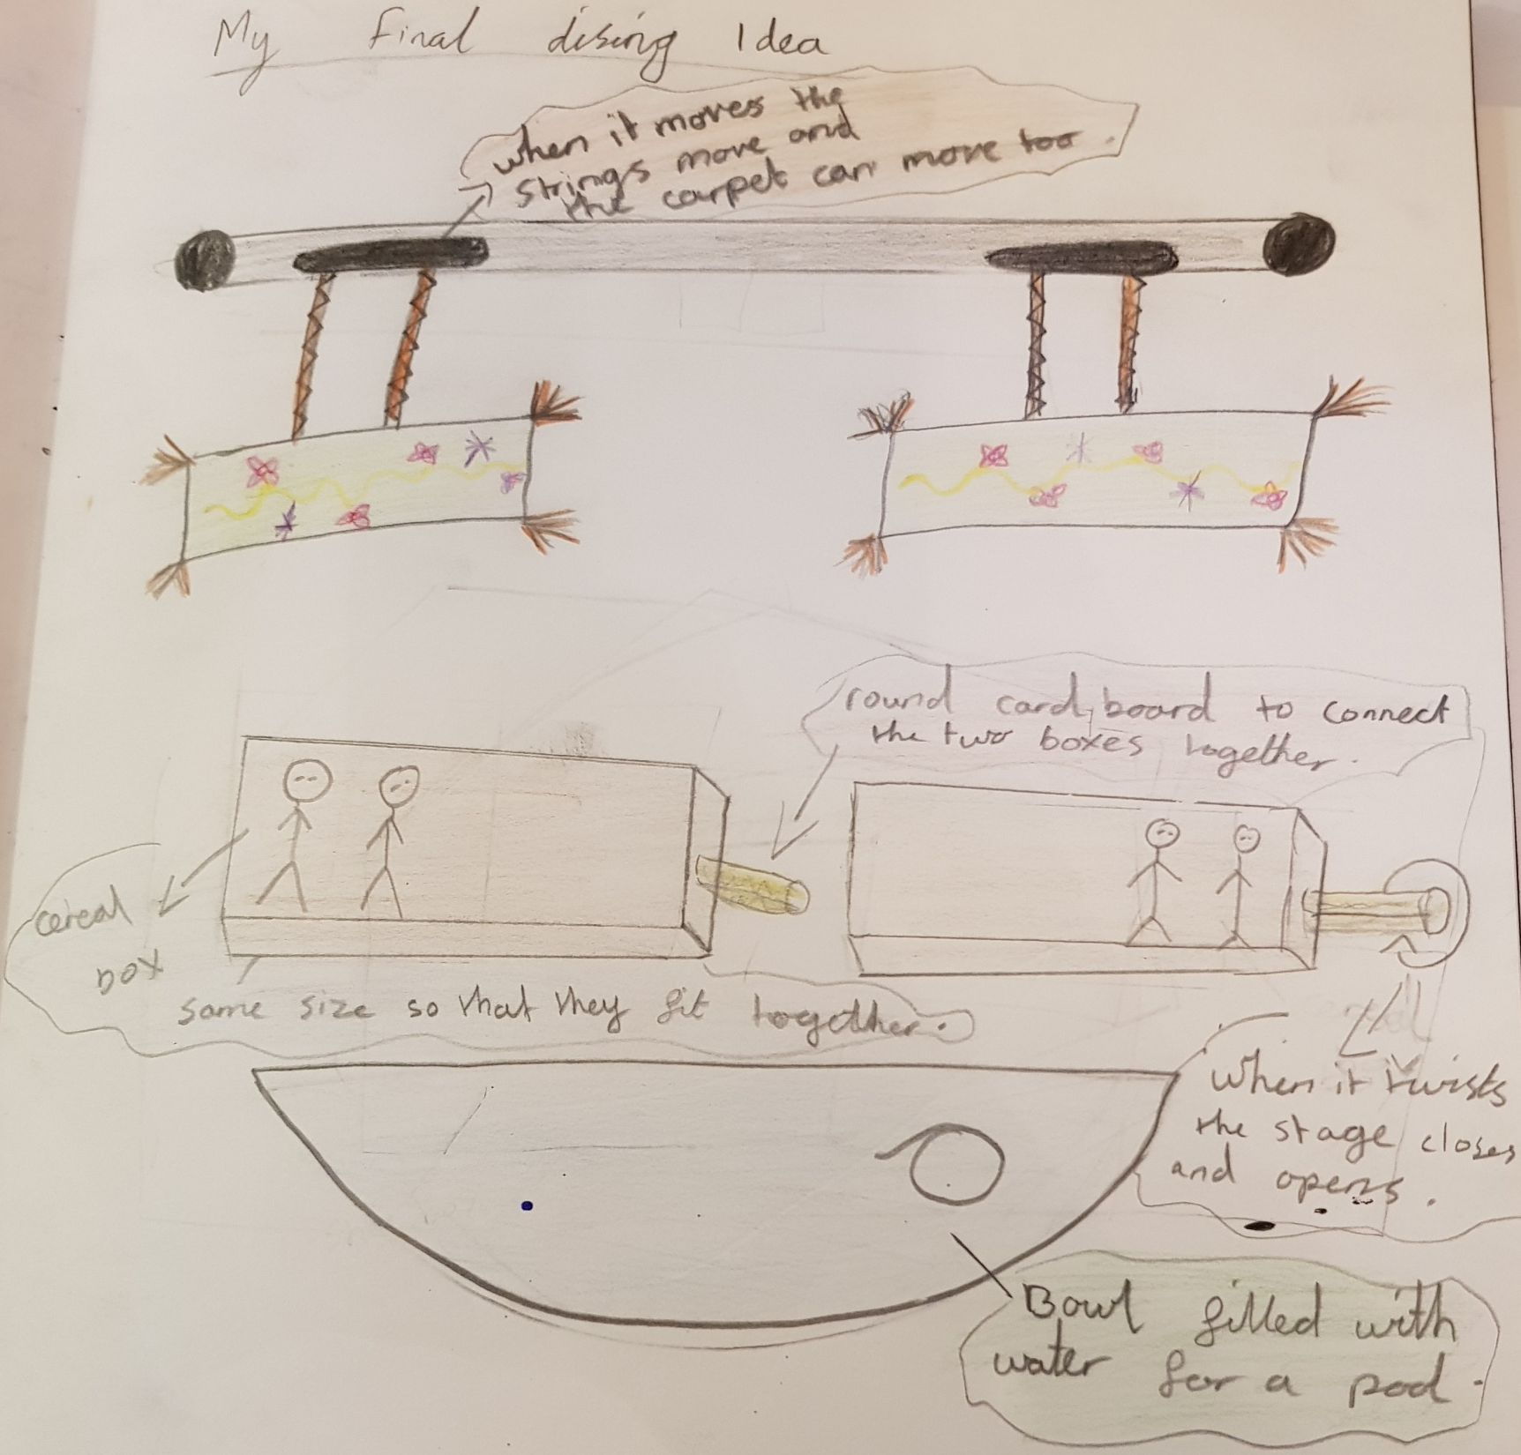
Notes:
SASH

Slide 17
10 top tips for the project!
Pick groups that will get on!
Allocate a team captain to resolve disputes.
Set up your room before sessions begin – maximising project time is important.
Pencil in a whole morning or afternoon each week for Ovo.
Don’t start cutting until you are sure – you can’t get back wasted material!
Be prepared for the visits of the Rolls Royce engineers. Their two half-day visits are the most important days in the project.
Get a glue gun (or two!)
Make use of the 3D printer nice and early.
Make use of parent contacts in your schools – engineers etc.
Get extra adults (or even parent volunteers) in for the ‘making’ days that take place.
Notes:
TOGETHER

Slide 18
Good luck!
Sasha Marius-Beeko
smarius-beeko@geschool.co.uk
07531555448
Good luck!
Mathew Safarian
m.safarian@franassisi.co.uk
07402934439
Questions?

